Slide 1
New Community Centre: Brookland Park

Slide 2
BROOKLANDS PARK COMMUNITY CENTRE
Coming soon
Start on site in Autumn 2024
Due to open Autumn 2025

Slide 3
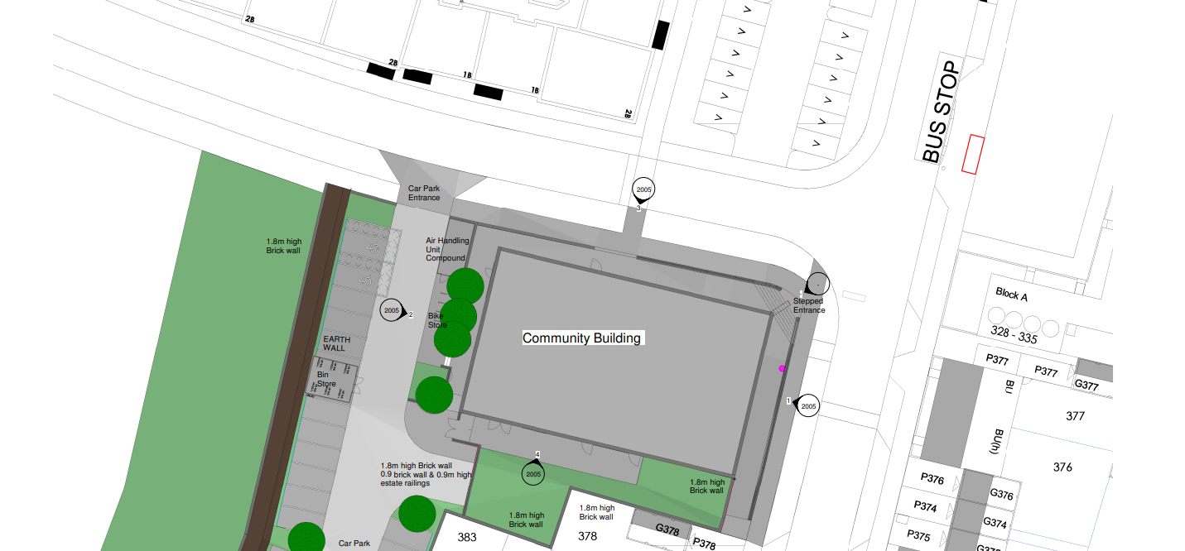
Location:

Slide 4
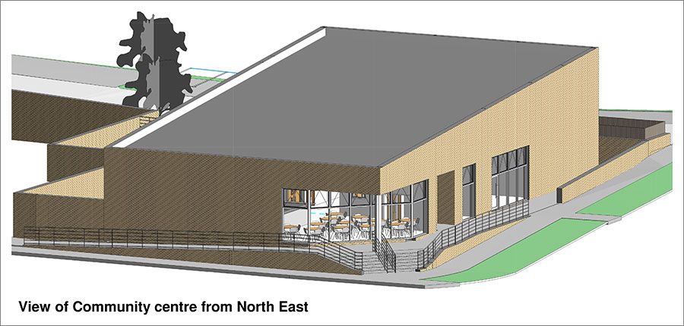

Slide 5
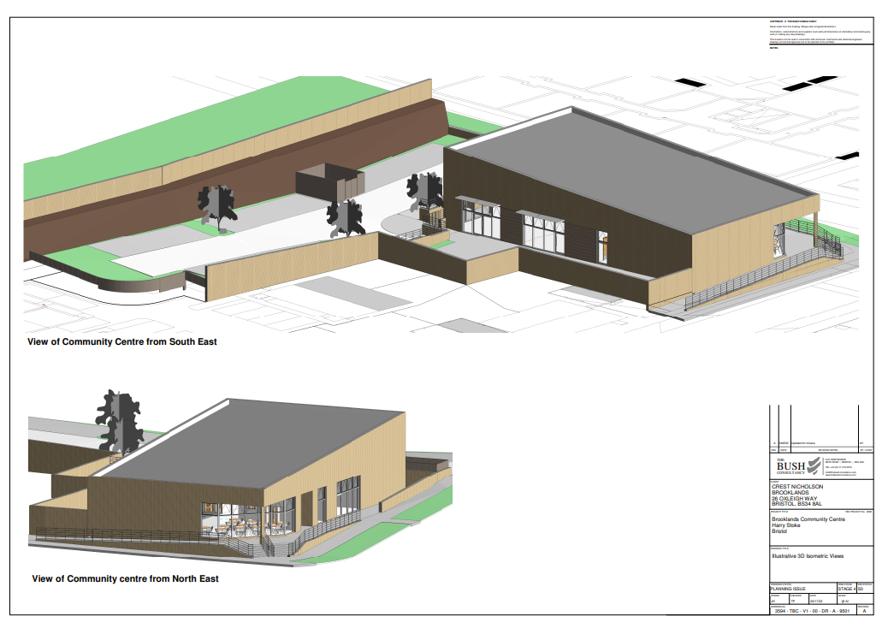
Community Centre for Brooklands Park

Slide 6
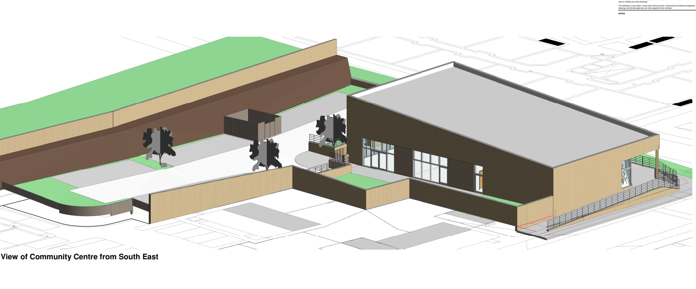
3 D showing Centre and Car Park

Slide 7
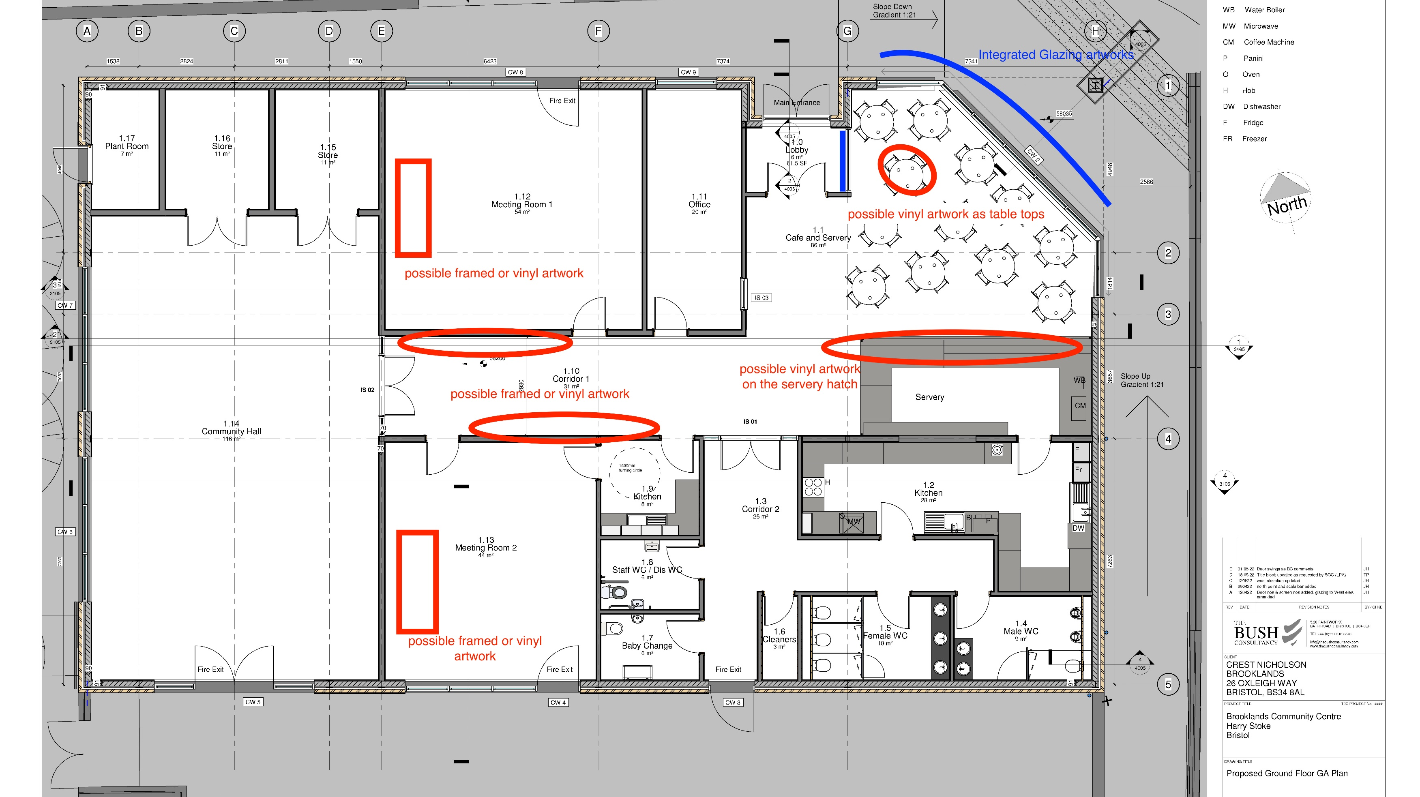

Slide 8
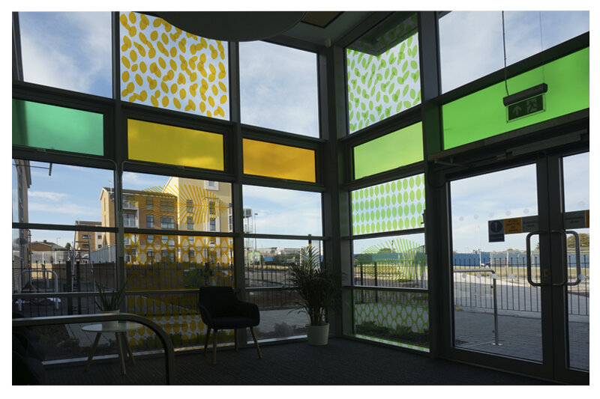

Public Art to be incorporated into the design

Slide 9
For more information about hire contact:
Stoke Gifford Parish Council
The Community Hall
Little Stoke Lane
Little Stoke
BS34 6HR
Tel: 01454 865202
clerk@stokegifford.org.uk

Slide 10
Construction
The building is being build by Crest Nicholson as part of the overall development of Brooklands Park.
South Gloucestershire Council is supporting Stoke Gifford Parish Council to run the centre
The Parish council are keen to ensure that the building will be a vibrant centre for the local community and want to involve residents to be part of its development.

